Slide 1
Linear Algebra
Lecture 36

Slide 2
Revision
Lecture I
Seg V and III

Slide 3
Eigenvalues and
Eigenvectors

Slide 4

If A is an n x n matrix, then a scalar is called an eigenvalue of A if there is a nonzero vector x such that Ax = x.
…

Slide 5
If A is a triangular matrix then the eigenvalues of A are the entries on the main diagonal of A.

Slide 6

If is an eigenvalue of a matrix A and x is a corresponding eigenvector, and if k is any positive integer, then is an eigenvalue of A^{k} and x is a corresponding eigenvector.

Slide 7

Characteristic
Equation

Slide 8
Similarity
If A and B are n x n matrices, then A is similar to B if there is an invertible matrix P such that P ⁻¹AP = B, or equivalently, A = PBP ⁻¹.
…

Slide 9
If n x n matrices A and B are similar, then they have the same characteristic polynomial and hence the same Eigenvalues.

Slide 10
Diagonalization
A square matrix A is said to be diagonalizable if A is similar to a diagonal matrix.
i.e. if A = PDP ⁻¹ for some invertible matrix P and some diagonal matrix D.

Slide 11
An n x n matrix A is diagonalizable if and only if A has n linearly independent eigenvectors.

Slide 12
An n x n matrix with n distinct eigenvalues is diagonalizable.

Slide 13
Eigenvectors
and Linear
Transformation

Slide 14
Matrix of LT
Let V and W be n-dim and m-dim spaces, and T be a LT from V to W.
To associate a matrix with T we chose bases B and C for V and W respectively
…

Slide 15
Given any x in V, the coordinate vector [x]_{B} is in R^{n} and the [T(x)]_{C} coordinate vector of its image, is in R^{m}
…

Slide 16
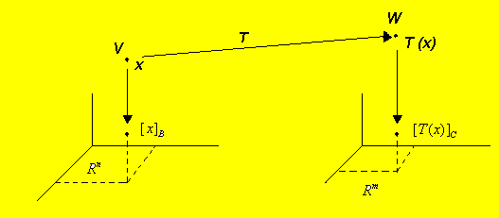

Slide 17
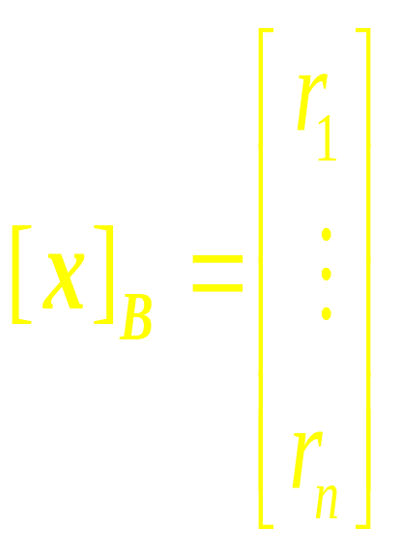
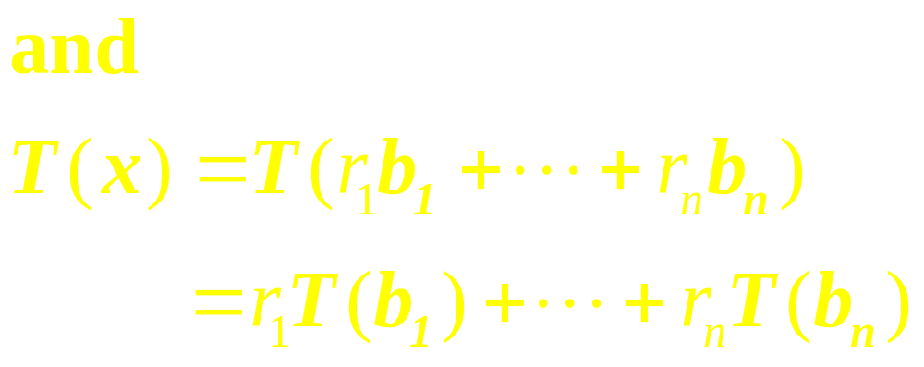
Connection between
[ x ]_{B} and [T(x)]_{C}
Let {b₁ ,…,b_{n}} be the basis B for V.
If x = r₁b₁ +…+ r_{n}b_{n}, then
…

Slide 18

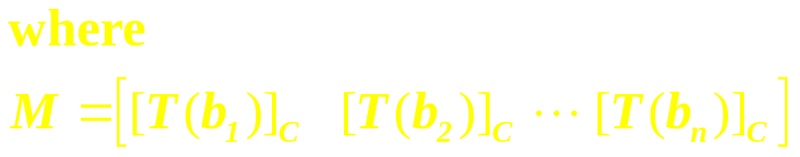
This equation can be written as

Slide 19
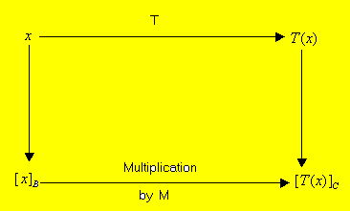
The Matrix M is the matrix representation of T, Called the matrix for T relative to the bases B and C

Slide 20
Similarity of Matrix
Representations

Slide 21
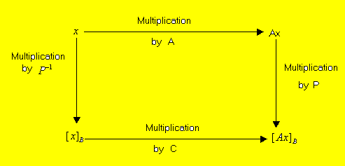
Similarity of two matrix
representations: A=PCP⁻¹

Slide 22
Complex
Eigenvalues

Slide 23


Definition
A complex scalar satisfies
if and only if there is a nonzero vector x in C^{n} such that We call a (complex) eigenvalue and x a (complex) eigenvector corresponding to .

Slide 24
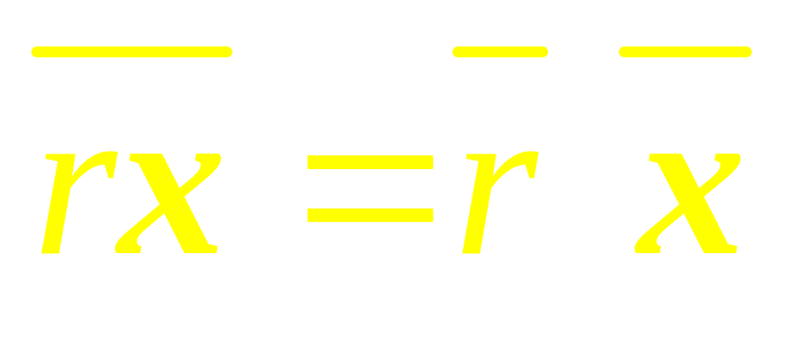
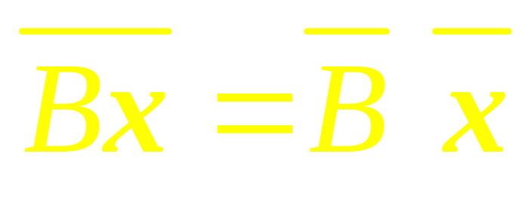
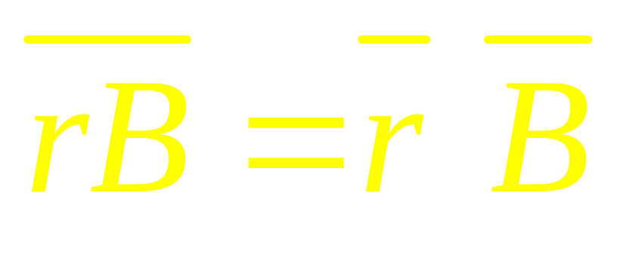
Note that

Slide 25
Discrete
Dynamical
System

Slide 26


Slide 27
Note
If A has two complex eigenvalues whose absolute value is greater than 1, then 0 is a repellor and iterates of x₀ will spiral outward around the origin.
…

Slide 28
Continued
If the absolute values of the complex eigenvalues are less than 1, the origin is an attractor and the iterates of x₀ spiral inward toward the origin.

Slide 29
Applications to
Differential
Equations

Slide 30

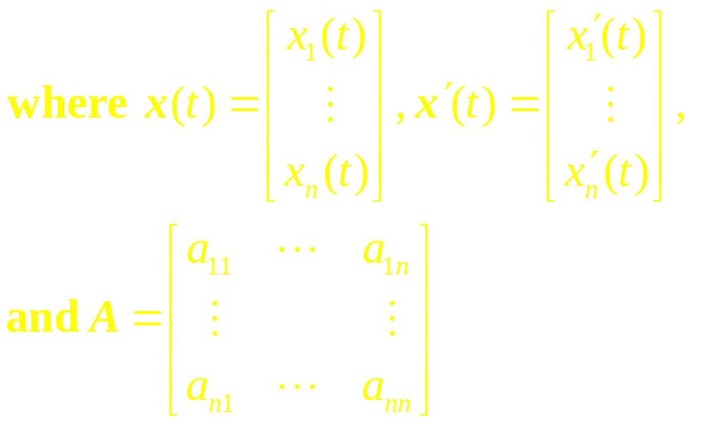
System as a Matrix
Differential Equation

Slide 31
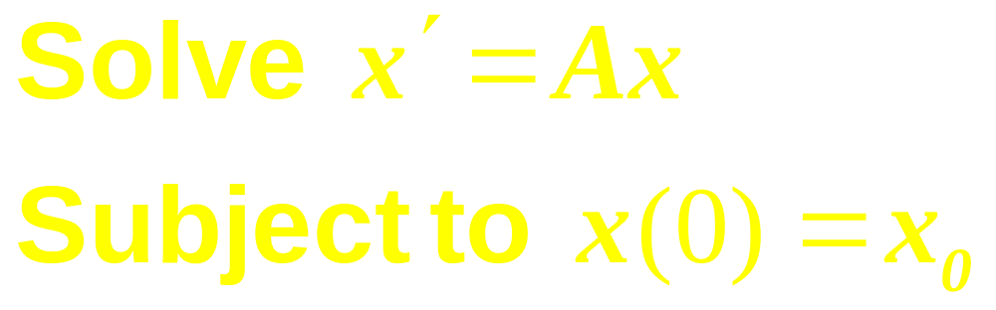
Initial Value
Problem

Slide 32
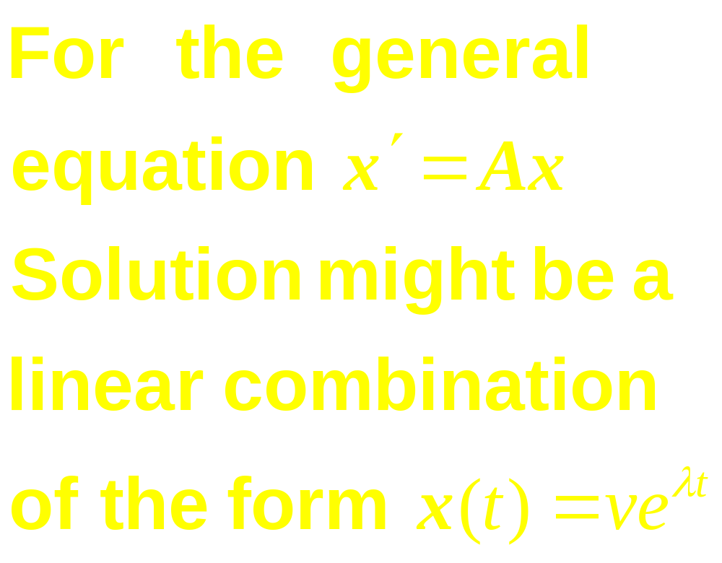
Observe
…

Slide 33
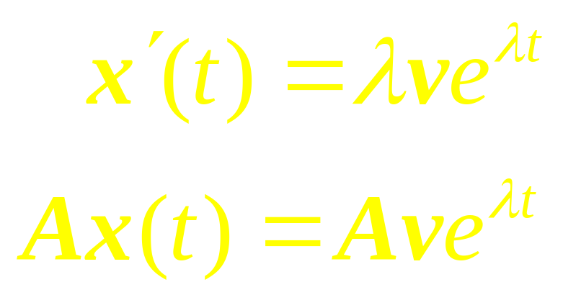
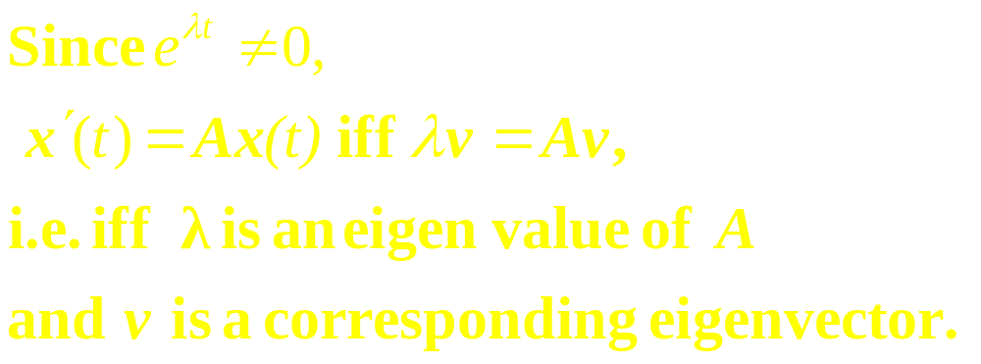
…

Slide 34
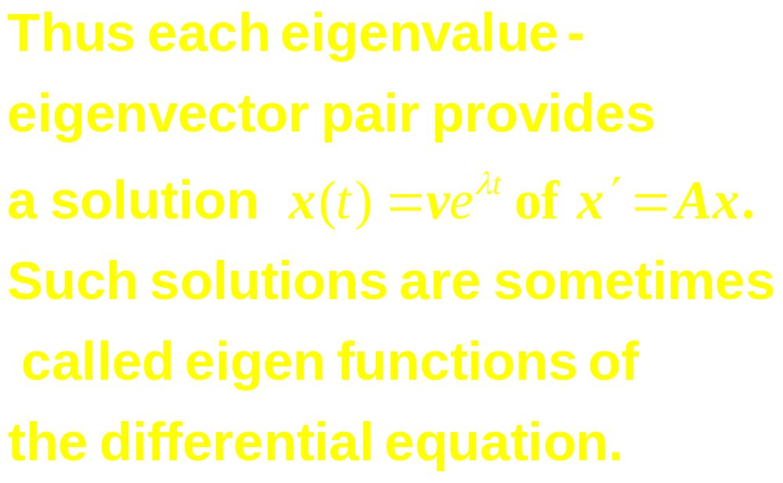

Slide 35
Revision
(Segment III)
Determinants

Slide 36
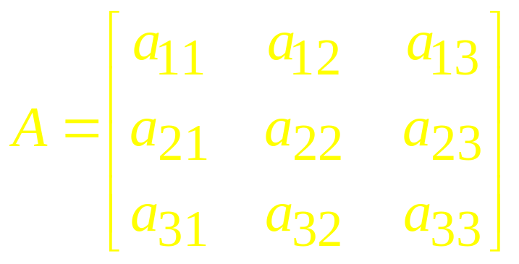
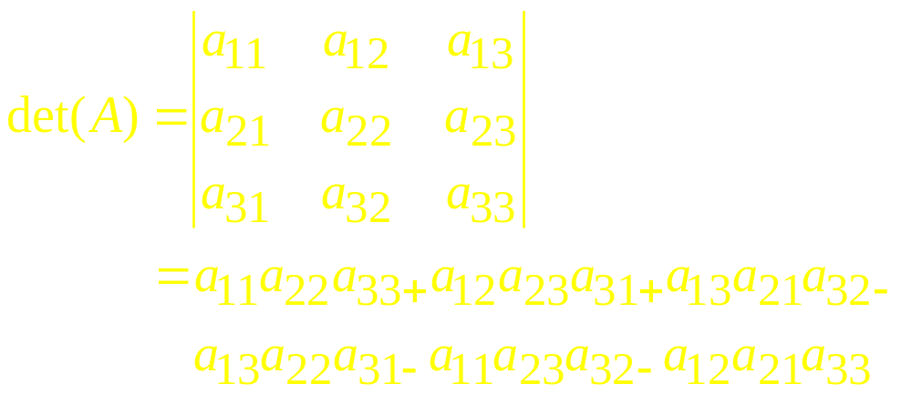
3 x 3 Determinant

Slide 37
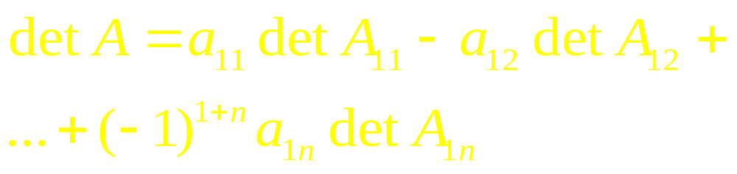

Expansion

Slide 38
Minor of a Matrix
If A is a square matrix, then the Minor of entry a_{ij} (called the ijth minor of A) is denoted by M_{ij} and is defined to be the determinant of the sub matrix that remains when the ith row and jth column of A are deleted.

Slide 39
Cofactor
The number
C_{ij}=(-1)^{i+j} M_{ij}
is called the cofactor
of entry a_{ij}
(or the ijth cofactor of A).

Slide 40


Cofactor Expansion Across the First Row

Slide 41
Theorem
The determinant of a matrix A can be computed by a cofactor expansion across any row or down any column.

Slide 42


The cofactor expansion across the ith row
The cofactor expansion down the jth column

Slide 43
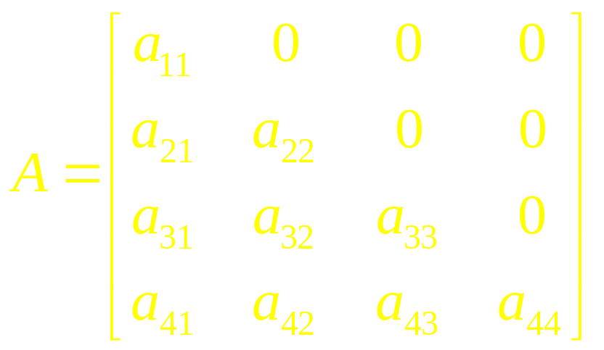

Theorem
If A is triangular matrix, then det (A) is the product of the entries on the main diagonal.

Slide 44
Properties of
Determinants

Slide 45
Theorem
Let A be a square matrix.
If a multiple of one row of A is added to another row to produce a matrix B, then det B = det A.
…..

Slide 46
Continue
If two rows of A are interchanged to produce B,
then det B = –det A.
If one row of A is multiplied by k to produce B, then
det B = k det A.

Slide 47
Theorems
If A is an n x n matrix, then
det A^{T} = det A.
If A and B are n x n matrices, then
det (AB)=(det A )(det B)

Slide 48
Cramer's Rule, Volume,
and
Linear Transformations

Slide 49
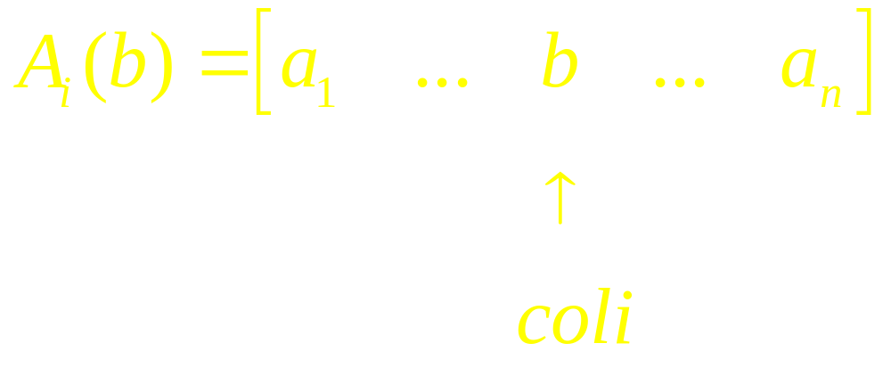
Observe
For any n x n matrix A and any b in R^{n}, let A_{i}(b) be the matrix obtained from A by replacing column i by the vector b.

Slide 50
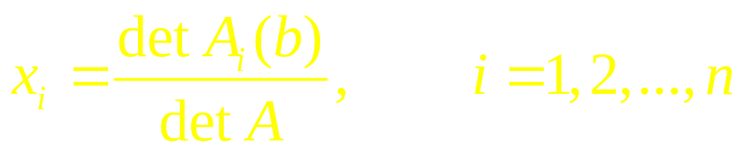
Theorem (Cramer's Rule)
Let A be an invertible n x n matrix. For any b in R^{n}, the unique solution x of Ax = b has entries given by

Slide 51

Theorem
Let A be an invertible matrix, then

Slide 52
Theorem
Let T: R² R² be the linear transformation determined by a 2 x 2 matrix A. If S is a parallelogram in R², then
{area of T (S)} = |detA|. {area of S}

Slide 53
Contiued
If T is determined by a 3 x 3 matrix A, and if S is a parallelepiped in R³, then
{volume of T (S)} = |detA|. {volume of S}

Slide 54
Linear Algebra
Lecture 36

